Slide 1
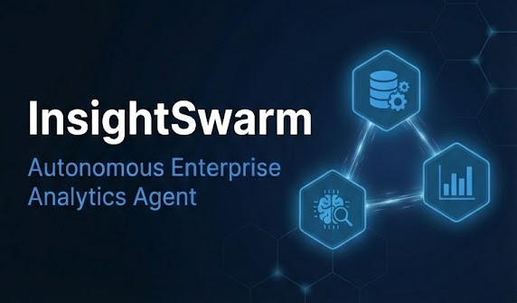

Slide 2
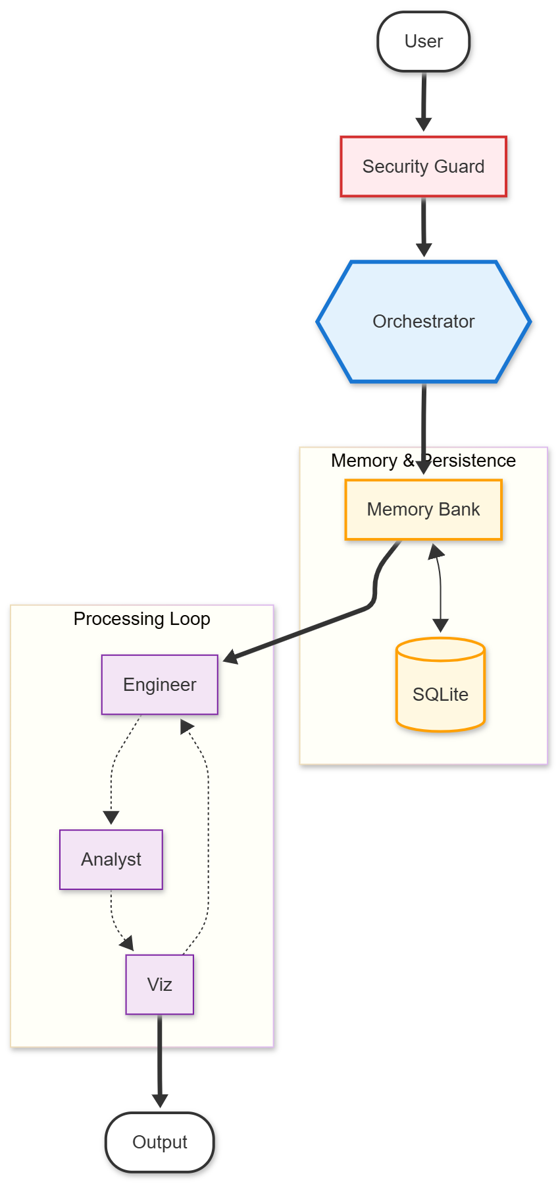

Slide 3
Github Link:
https://github.com/agatapurwa/insightswarm-enterprise-agent

